Slide 1
NOWCASTING INDUSTRIAL PRODUCTION INDEX WITH TOLL DATA
New Data Sources in Official Statistics
Dr Peter Knížat
Statistical Office of the Slovak Republic
Comenius University in Bratislava

Slide 2
LEARNING OBJECTIVES
Learning Objectives – after completing this session, participants will be able to
explain why administrative big data are increasingly used in official statistics
construct a monthly truck-passage index from high-frequency toll records → estimate bilateral and multilateral indices
compare estimated indices with the Industrial Production Index (IPI)
decompose time series into cyclical components using Empirical Mode Decomposition (EMD)
reproduce the complete methodology in R
Key Question – Can road transport activity provide an early indication of industrial production before official statistics become available?

Slide 3
MOTIVATION – NOWCASTING
Why is nowcasting important?
Official macroeconomic indicators are rarely available immediately after the reference period. Examples:
  Gross Domestic Product (GDP)
  Industrial Production Index (IPI)
  Retail Trade
  Employment
  Construction Output
These indicators usually become available several weeks after the end of the month.

Slide 4
MOTIVATION – POLICY
Policy problem
Governments and central banks cannot wait several weeks before making decisions. They require information describing
the current state of the economy,
recent changes,
possible turning points.
Therefore, statistical offices increasingly investigate alternative data sources that become available almost immediately after economic activity occurs.

Slide 5
INTRODUCTION
Based on the published study: Knížat, P. et al. Nowcasting industrial production index with high-frequency toll data. In: Statistical Journal of the IAOS, 2025; 41(1): 102-111.
https://doi.org/10.1177/18747655241307540
focus both on theory and practice
original data consist of millions of electronic toll records collected automatically every day → capture freight movement through sections of road network
reproduce each methodological step using simulated data that have the same structure as the confidential dataset used in the paper

Slide 6
WHY TOLL DATA?
Most industrial production requires: Raw materials → Transportation → Production → Distribution → Customers
if industrial production increases → the transportation of goods is expected to increase as well.
Therefore, truck traffic (freight) can potentially serve as an early indicator of industrial production.
simulation of the monthly freight movement through the section of roads in R
Question: Can you think of other administrative or digital data sources suitable for nowcasting?

Slide 7
ELECTRONIC TOLL SYSTEM IN SLOVAKIA
Data Generation Process:
automatically records the movement of heavy vehicles travelling on monitored road sections
every vehicle above the legal weight threshold is equipped with an on-board unit that communicates with the satellite-based toll infrastructure
a passage through a camera-installed point of the road section generates a digital record
Each digital record contains: vehicle identifier, date and time of passage, road section identifier, vehicle characteristics, country of registration.

Slide 8
TOLL DATA – ADVATAGES AND LIMITATIONS
Advantages
  fully automatic data collection
  no additional respondent burden
  available shortly after economic activity occurs → generated continuously and therefore become available shortly after economic activity occurs
Limitations
  data do not contain information on the transported goods
  transit vehicles cannot easily be distinguished from vehicles contributing to domestic production
  only road freight transport is observed, while rail and other transport modes are excluded

Slide 9
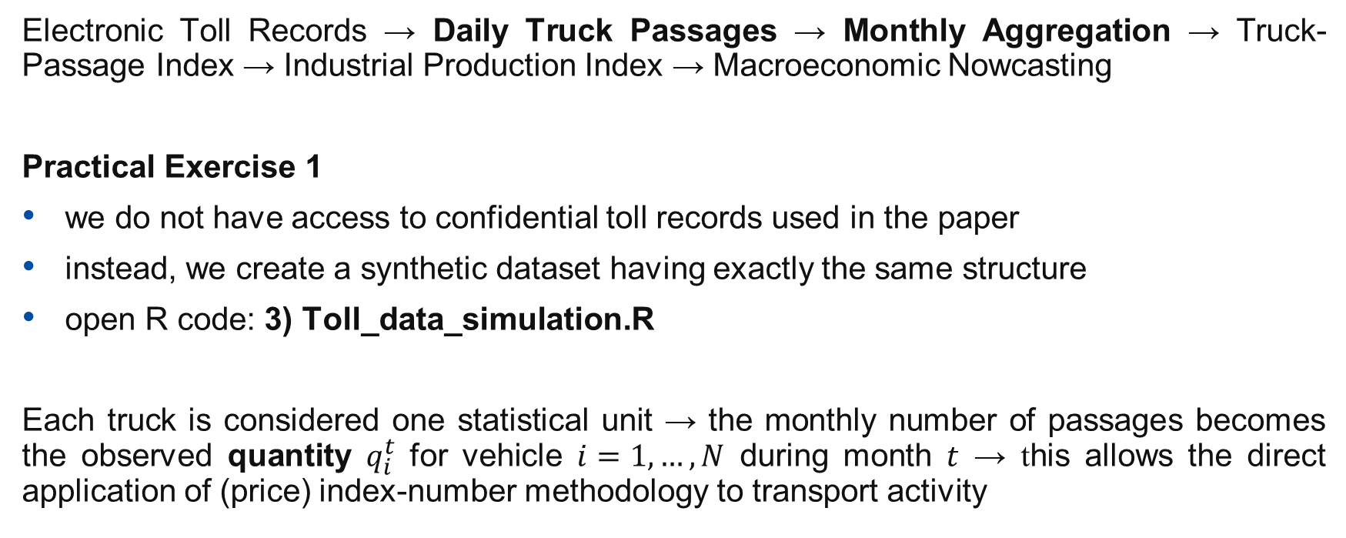
CONCEPTUAL FRAMEWORK
Electronic Toll Records → Daily Truck Passages → Monthly Aggregation → Truck-Passage Index → Industrial Production Index → Macroeconomic Nowcasting
Practical Exercise 1
we do not have access to confidential toll records used in the paper
instead, we create a synthetic dataset having exactly the same structure
open R code: 3) Toll_data_simulation.R
Each truck is considered one statistical unit → the monthly number of passages becomes the observed quantity $q_{i}^{t}$ for vehicle $i=1,…,N$ during month $t$ → this allows the direct application of (price) index-number methodology to transport activity

Slide 10
DICUSSION → DATA
What is missing in simulated dataset?
naive distribution of data – a truck appears in each month (no new and disappearing trucks)
other data limitations?
Why is monthly aggregation preferable to using daily / weekly observations?
less noise
comparison with official statistics – Industrial Production Index
The next step is therefore to understand how a monthly index is constructed.

Slide 11
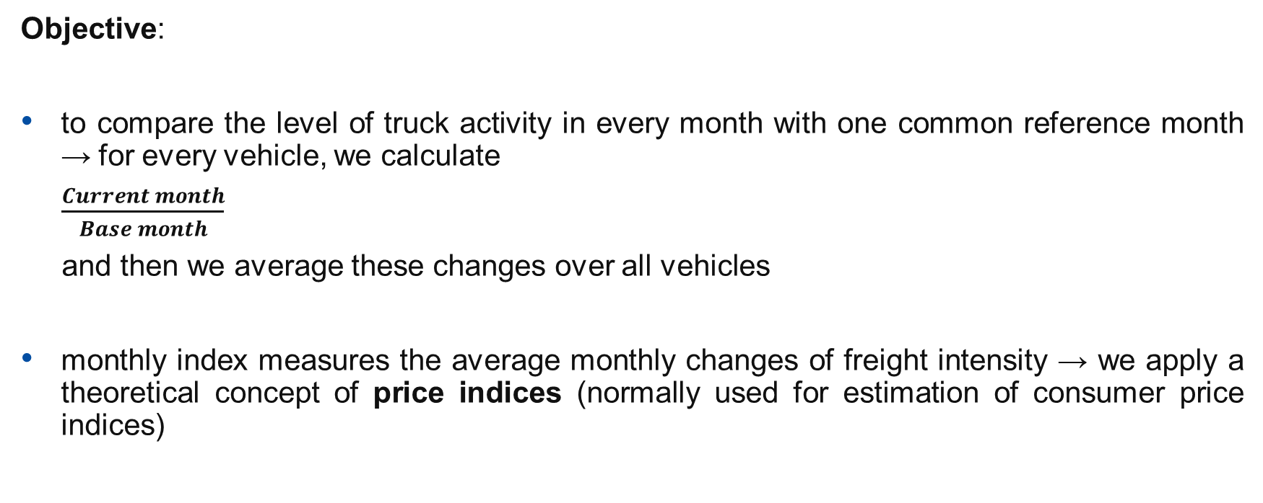
CONCEPTS OF MONTHLY INDICES
Objective:
to compare the level of truck activity in every month with one common reference month → for every vehicle, we calculate
$\frac{Current month}{Base month}$
and then we average these changes over all vehicles
monthly index measures the average monthly changes of freight intensity → we apply a theoretical concept of price indices (normally used for estimation of consumer price indices)

Slide 12
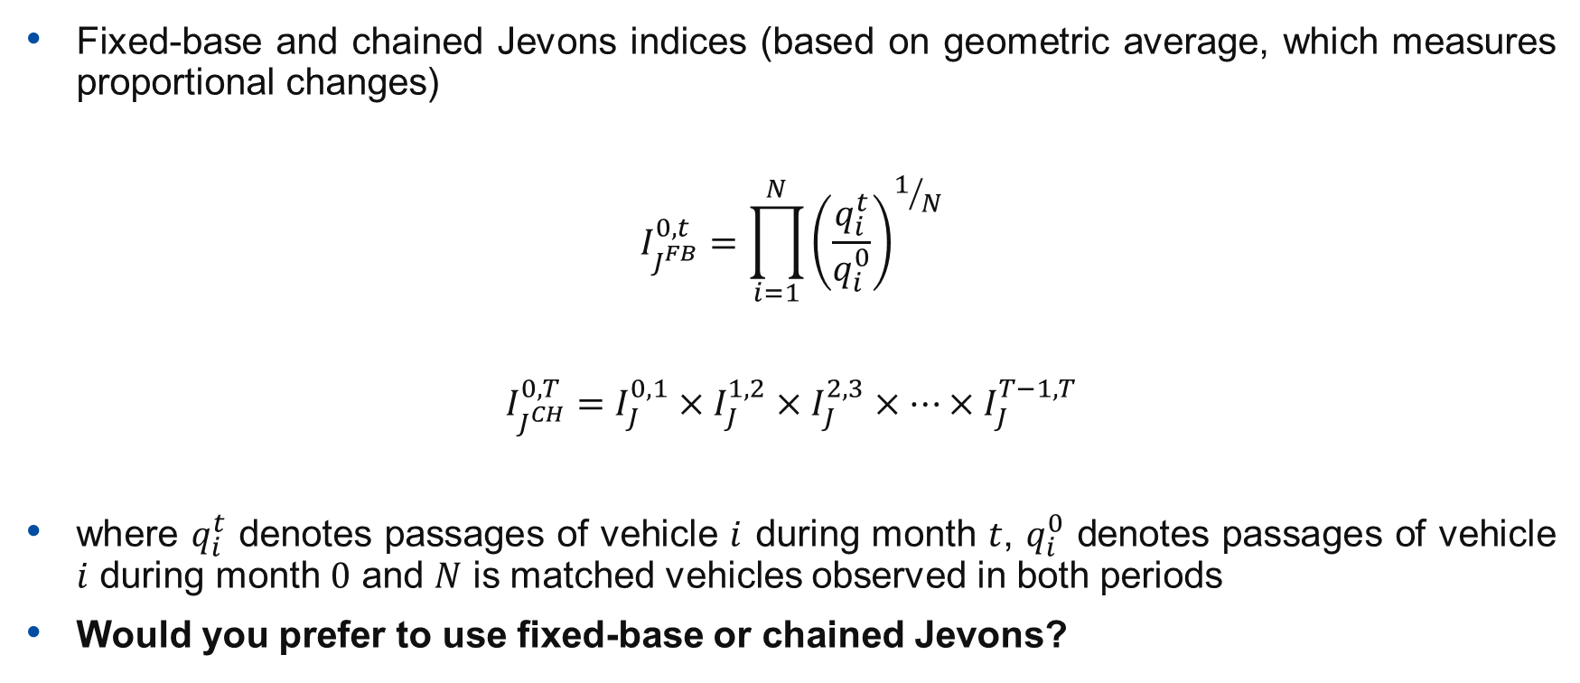
BILATERAL INDEX
Fixed-base and chained Jevons indices (based on geometric average, which measures proportional changes)
$$I_{J^{FB}}^{0,t}=\prod_{i=1}^{N}{{\left(\frac{q_{i}^{t}}{q_{i}^{0}}\right)}^{1/N}}$$
$$I_{J^{CH}}^{0,T}=I_{J}^{0,1}×I_{J}^{1,2}×I_{J}^{2,3}×…×I_{J}^{T−1,T}$$
where $q_{i}^{t}$ denotes passages of vehicle $i$ during month $t$, $q_{i}^{0}$ denotes passages of vehicle $i$ during month $0$ and $N$ is matched vehicles observed in both periods
Would you prefer to use fixed-base or chained Jevons?

Slide 13
MULTILATERAL METHODS FOR INDEX COMPILATION
Problem
Suppose we observe the following vehicles
Question: Can we still construct a bilateral index? Yes, but the matched sample becomes progressively smaller, leading to increased sampling variability and potential bias due to vehicle churn
Motivation: Use of multilateral methods for index compilation as a way to overcome this limitation
January | February | March
Truck A | Truck A | Truck A
Truck B | Truck C | Truck D
Truck C | Truck D | Truck E

Slide 14
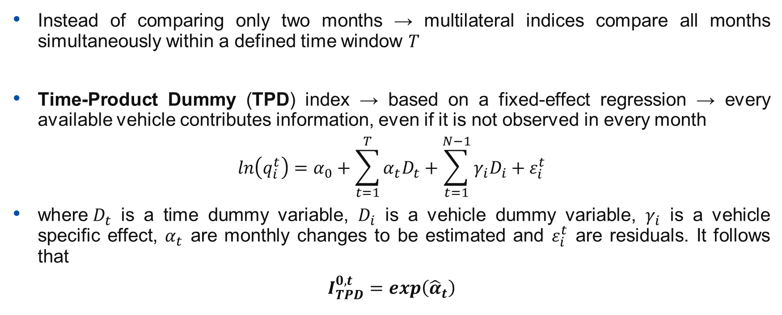
MULTILATERAL INDEX – TIME-PRODUCT DUMMY (TPD)
Instead of comparing only two months → multilateral indices compare all months simultaneously within a defined time window $T$
Time-Product Dummy (TPD) index → based on a fixed-effect regression → every available vehicle contributes information, even if it is not observed in every month
$$ln\left(q_{i}^{t}\right)=α_{0}+\sum_{t=1}^{T}{α_{t}D_{t}}+\sum_{t=1}^{N−1}{γ_{i}D_{i}}+ε_{i}^{t}$$
where$D_{t}$ is a time dummy variable, $D_{i}$ is a vehicle dummy variable, $γ_{i}$ is a vehicle specific effect, $α_{t}$ are monthly changes to be estimated and $ε_{i}^{t}$ are residuals. It follows that
$$I_{TPD}^{0,t}=exp\left({\hat{α}}_{t}\right)$$

Slide 15
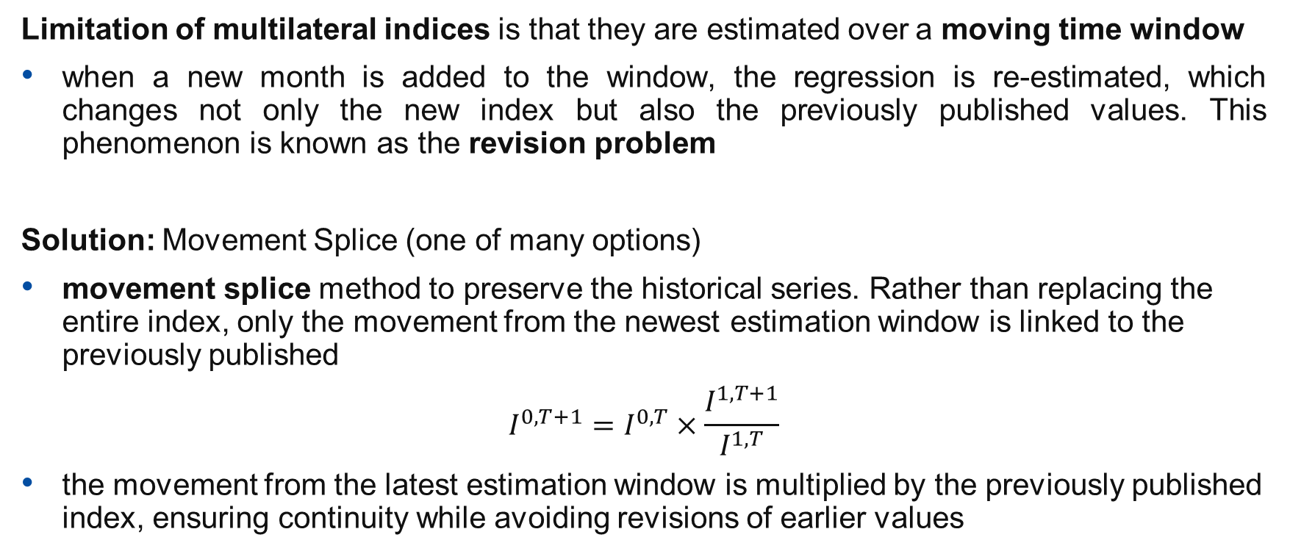
MULTILATERAL INDEX – REVISION PROBLEM
Limitation of multilateral indices is that they are estimated over a moving time window
when a new month is added to the window, the regression is re-estimated, which changes not only the new index but also the previously published values. This phenomenon is known as the revision problem
Solution: Movement Splice (one of many options)
movement splice method to preserve the historical series. Rather than replacing the entire index, only the movement from the newest estimation window is linked to the previously published
$$I^{0,T+1}=I^{0,T}×\frac{I^{1,T+1}}{I^{1,T}}$$
the movement from the latest estimation window is multiplied by the previously published index, ensuring continuity while avoiding revisions of earlier values

Slide 16
INDUSTRIAL PRODUCTION INDEX
Empirical Results: Truck-Passage Index vs Industrial Production Index
next step is to evaluate whether estimated Truck-Passage Index capture the dynamics of industrial production → comparison of the fixed-base Jevons Index, chained Jevons Index, and Time-Product Dummy (TPD) Index with the official Industrial Production Index (IPI) published by the Statistical Office of the Slovak Republic
simulate IPI in R and compare graphically → compare with original time series from the paper
What do you observe?

Slide 17
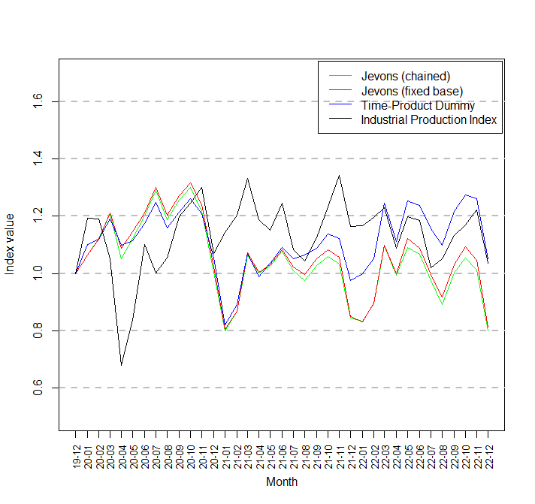
FIGURES – INDICES (PAPER)
All three truck-passage indices show very similar dynamics – the fixed-base Jevons, chained Jevons and TPD indices generally identify the same increases, decreases and turning points – the largest differences between index methods appear toward the end of the period when the TPD index tends to remain somewhat higher, while the two Jevons indices are very close to each other
Truck traffic and industrial production are related but not identical economic signals.

Slide 18
DECOMPOSITION OF INDICES
Why decompose the index? → although the indices exhibit similar movements, they contain several different types of variation simultaneously
long-term movements
business-cycle fluctuations
seasonal behaviour
irregular noise
We are interested to study the cyclical behaviour of industrial production more closely, the paper applies Empirical Mode Decomposition (EMD) → unlike traditional filters, EMD is designed for non-linear and non-stationary time series and decomposes the original series into a finite number of Intrinsic Mode Functions (IMFs)

Slide 19
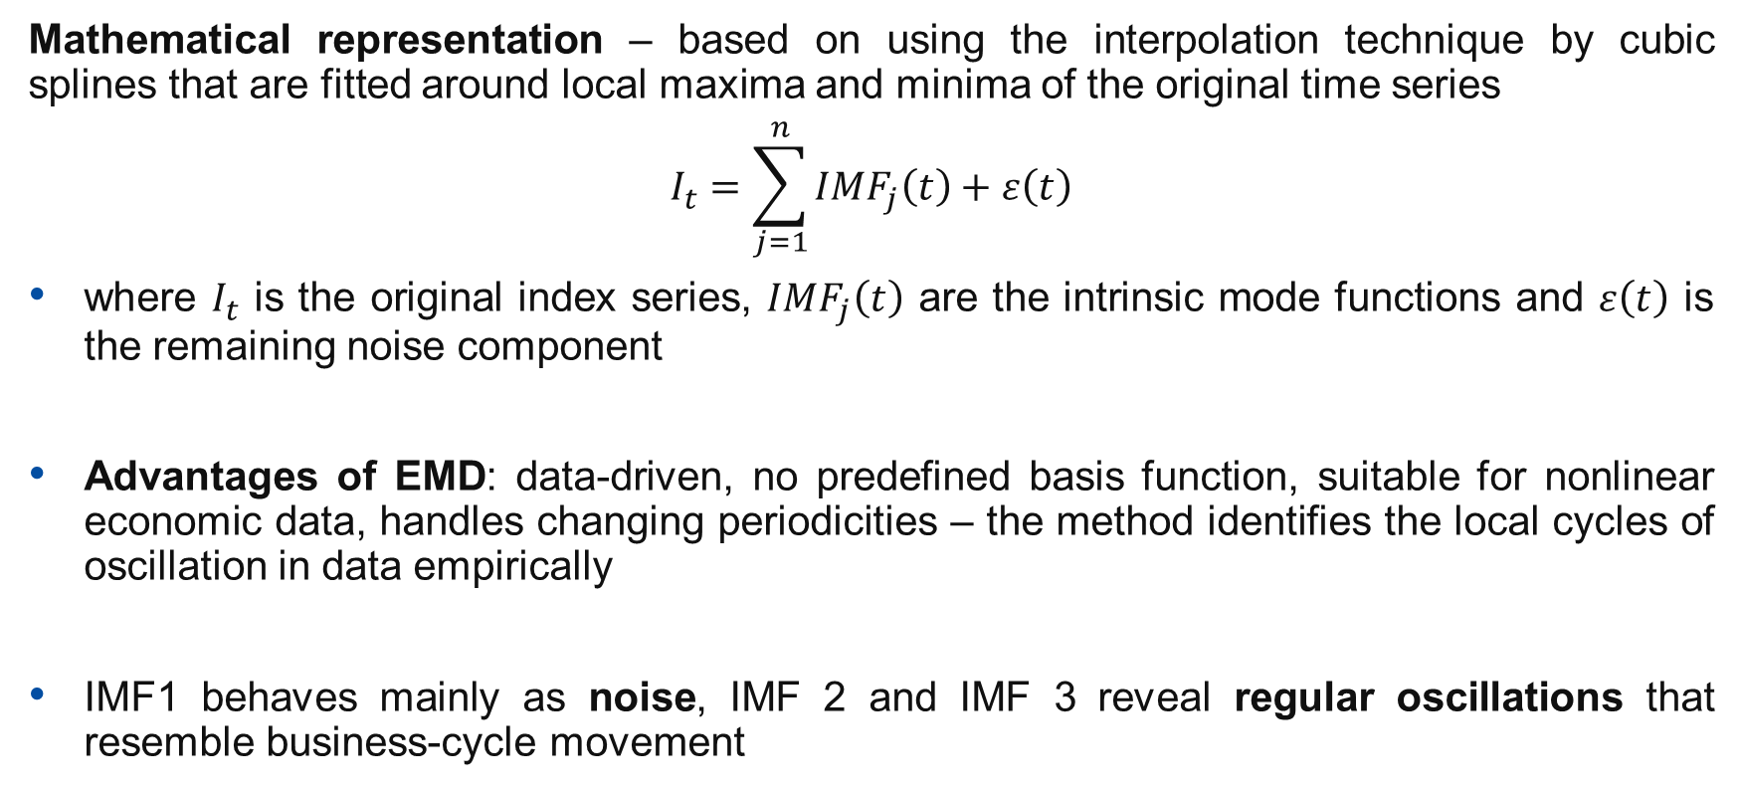
EMPIRICAL MODE DECOMPOSITION
Mathematical representation – based on using the interpolation technique by cubic splines that are fitted around local maxima and minima of the original time series
$$I_{t}=\sum_{j=1}^{n}{{IMF}_{j}\left(t\right)}+ε\left(t\right)$$
where $I_{t}$ is the original index series, ${IMF}_{j}\left(t\right)$ are the intrinsic mode functions and $ε\left(t\right)$ is the remaining noise component
Advantages of EMD: data-driven, no predefined basis function, suitable for nonlinear economic data, handles changing periodicities – the method identifies the local cycles of oscillation in data empirically
IMF1 behaves mainly as noise, IMF 2 and IMF 3 reveal regular oscillations that resemble business-cycle movement

Slide 20
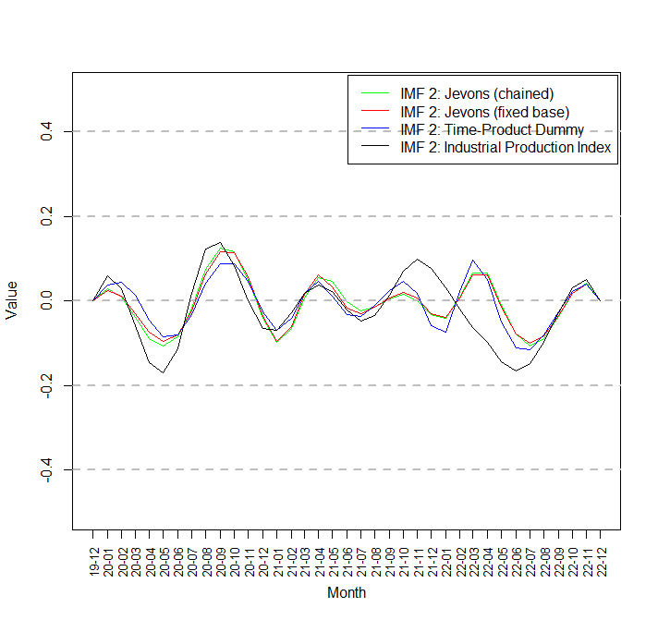
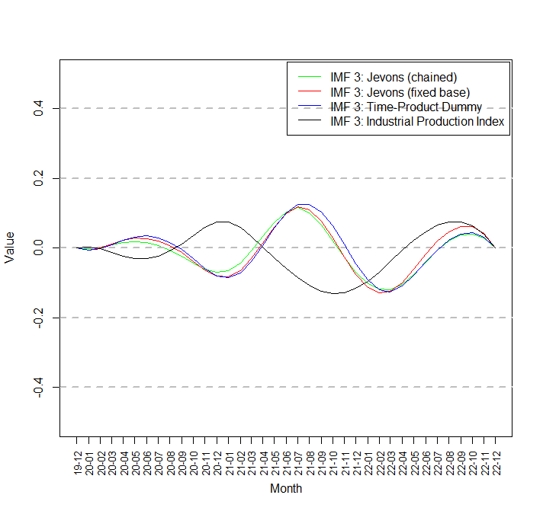
FIGURES – IMF 2 & 3 (PAPER)
IMF 2 appears to represent the business-cycle component of the series; IMF 3 of IPI often behaves counter-cyclically relative to Truck-Passage Index
EMD decomposes the time series, but economic interpretation remains challenging – one of the current research topics in macroeconomic time-series analysis

Slide 21
QUESTIONS
Can you apply similar analysis in your country – access to administrative data, representativeness of freight? Would such an index be useful for nowcasting (a component of) the industrial output?
Why might truck traffic react more quickly than industrial production during turning points of the business cycle?
Any other questions or thoughts?

Slide 22
DISCUSSION
Several important advantages of using toll data for official statistics:
administrative data are generated automatically
data are available much earlier than official economic indicators
the truck-passage indices follow movements in industrial production
EMP provides additional insight into cyclical behaviour but requires longer time series for robust economic interpretation
Limitations
no information on transported goods
transit vehicles cannot be fully identified
only road transport is observed

Slide 23
Thank you
Contact: peter.knizat@statistics.sk
knizat3@uniba.sk

